Slide 1


Programme management:
are we there yet?
Michael Young
BSc, MBA, IPMA Level A©, CPPD, FAIPM, FAPM, FAIM, MACS(Snr), MCIPS, CP
Adjunct Associate Professor
www.gpm.world

Slide 2
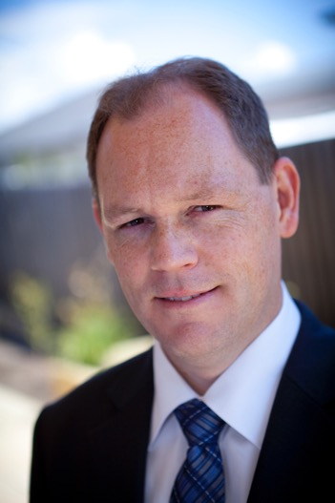

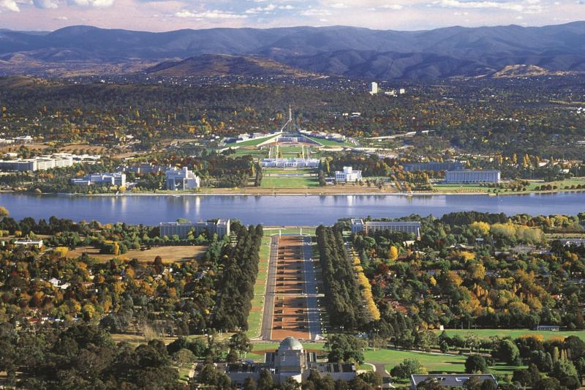

Notes:
Pracademic -
Largest flower festival in the southern hemisphere with over 1 million flowers (mainly tulips) and over 500,000 visitors.
Based on 'Keukenhof' garden in The Netherlands

Slide 3
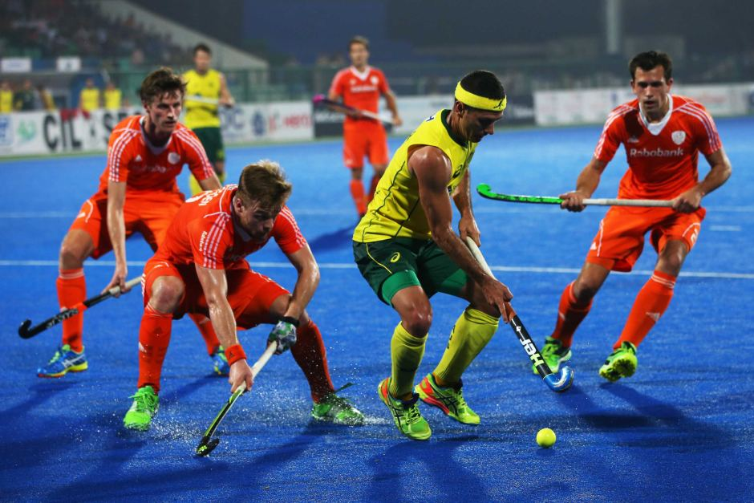
Notes:
Concepts are not well understood

Slide 4
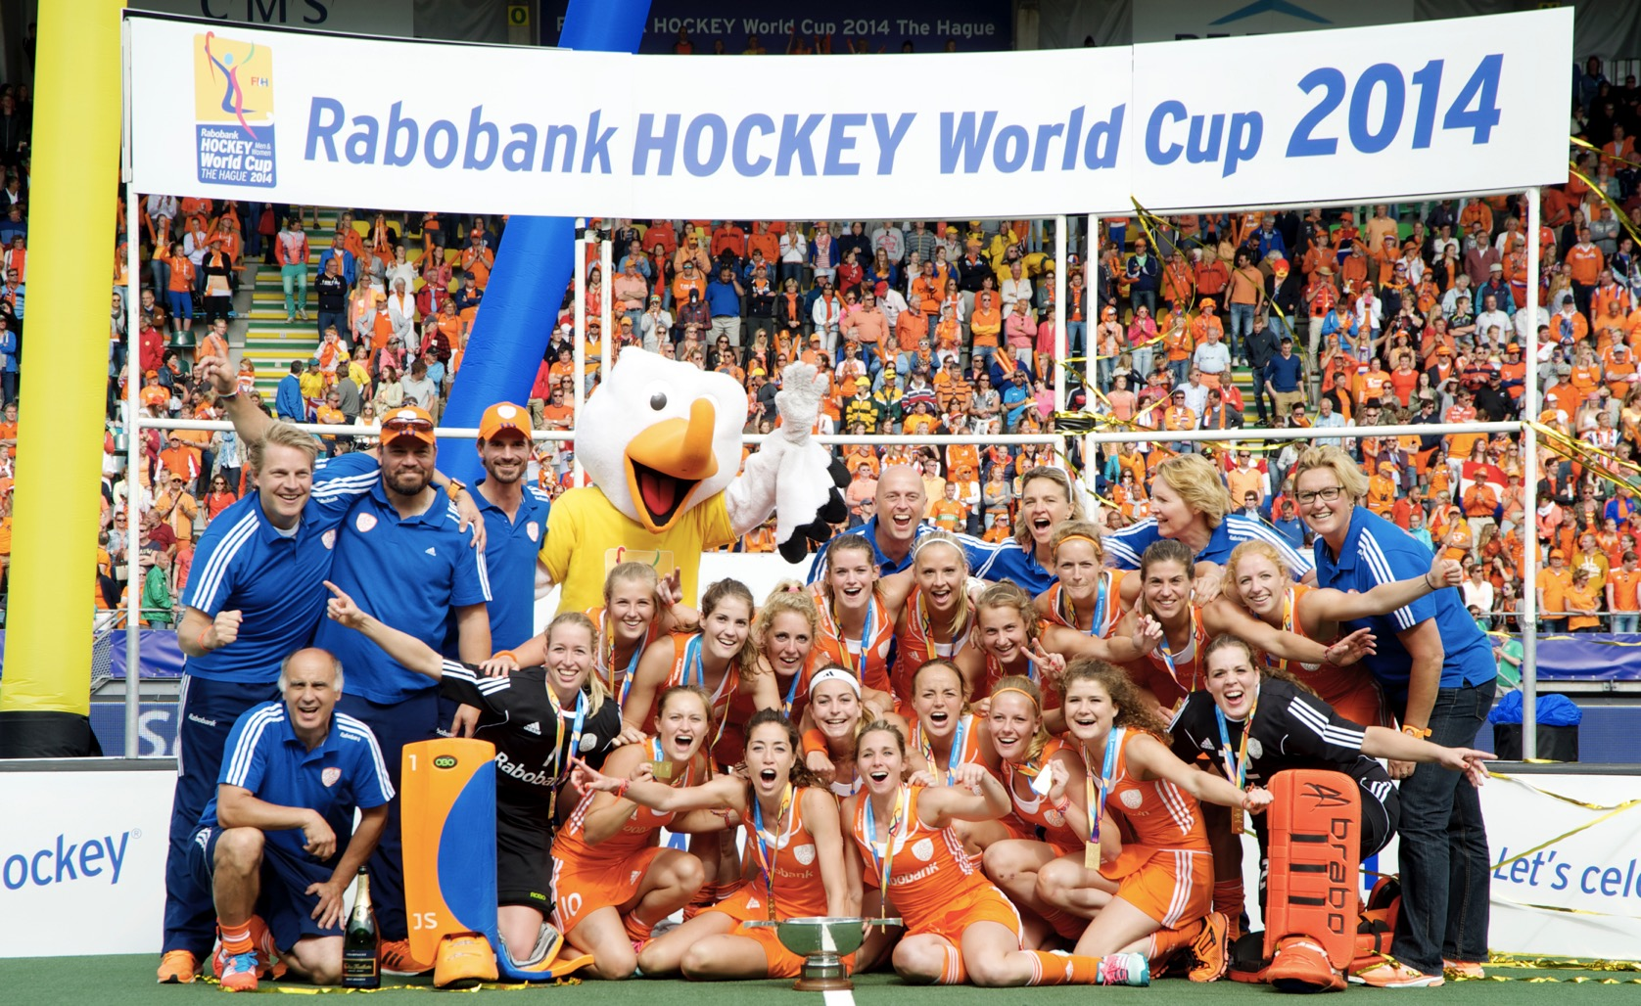
Notes:
Concepts are not well understood

Slide 5
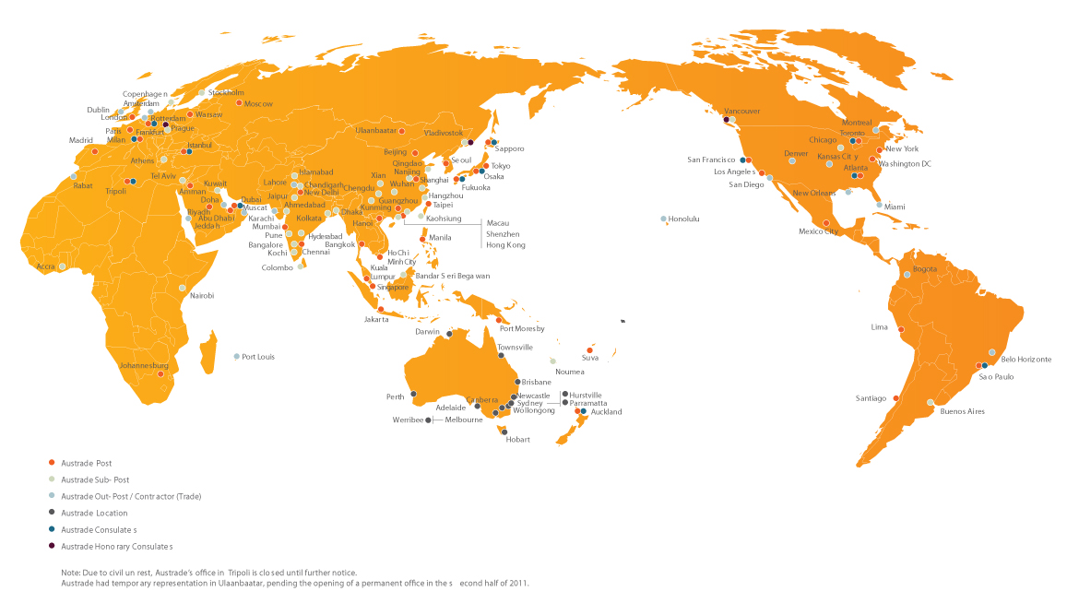
Technology Refresh Program, 2002

Slide 6
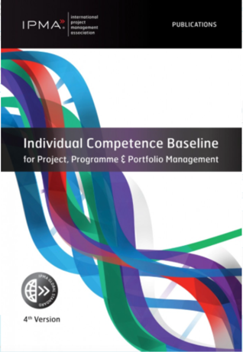
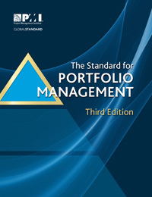
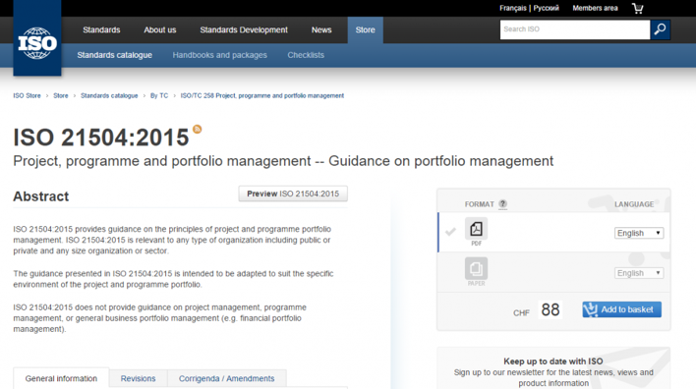










Slide 7






Who or what is GPM?
Sustainable Project Management Professional Development Organization
Services in over 145 Countries
  Training through partners (Corp., University, Association)
  Certification of individuals (GPM-b™, GPM®, and GPM-m™)
  Methodology (PRiSM)
  Organizational Sustainability Assessments (PSM3™)
  Centre of Excellence
  Standards (P5)
Walking the Talk
Notes:
As you saw from my title slide, I am with GPM. Who or what is that? We are a certified social enterprise (we believe in paying taxes and putting into practice what we preach… We funciton like a non-profit in all other aspects.

Slide 8
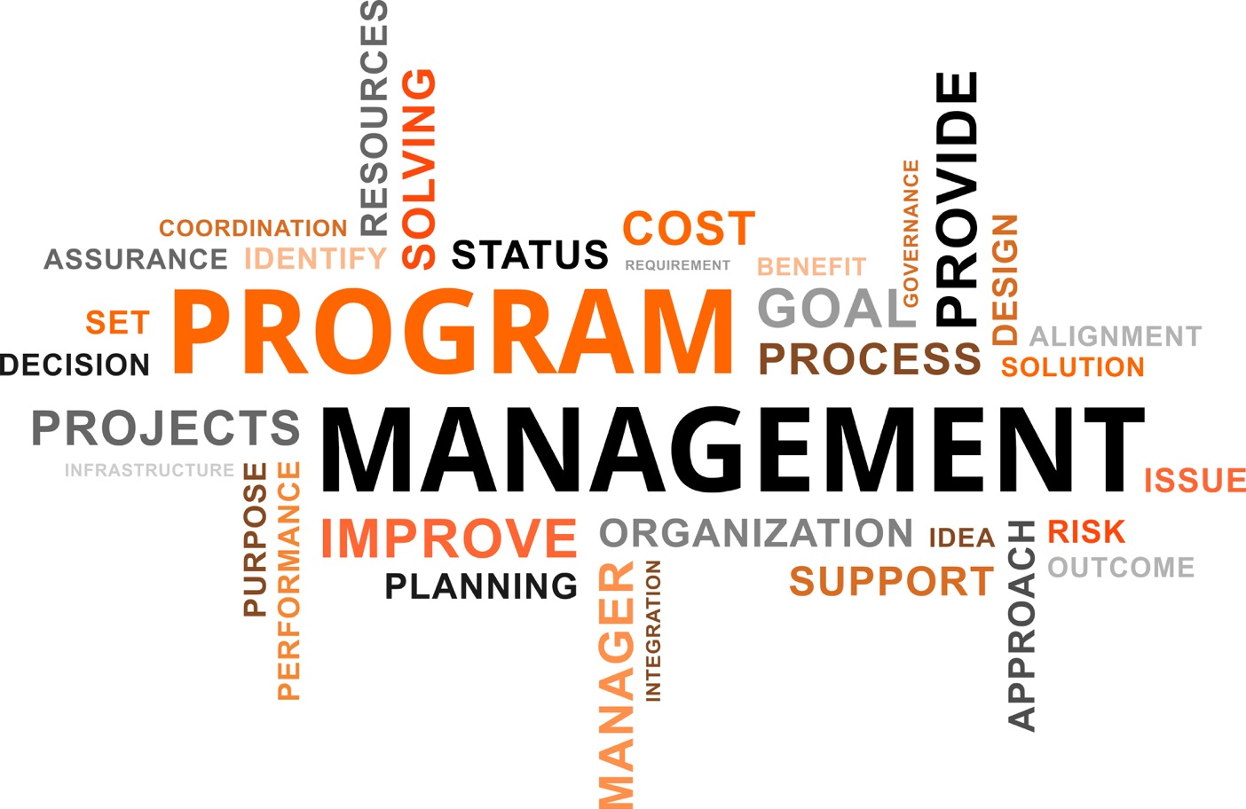
Notes:
3 Key Problems
No clear universal definition
Program mgmt is often pgm mgt according to project managers
Low levels of maturity and practice

Slide 9
“When individuals involved in programs meet one another they spend time trying to understand what the other means by program management”
(Pellegrinelli and Partington 2006)
Notes:
Programs are different

Slide 10
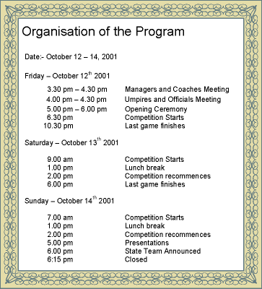

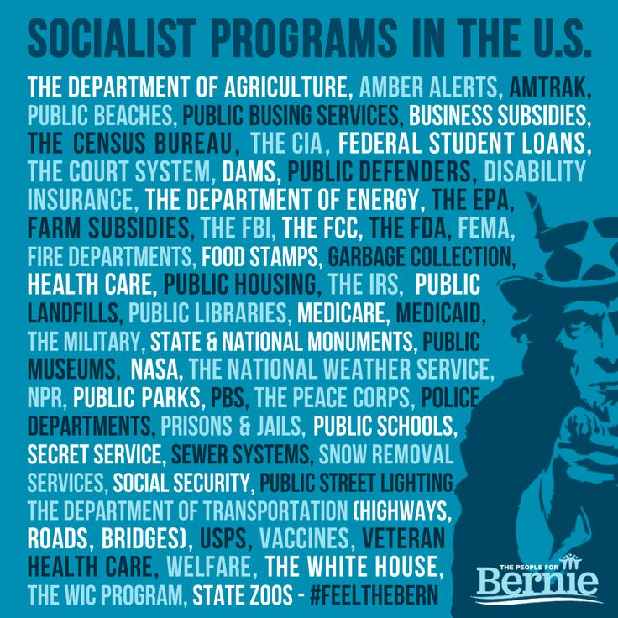
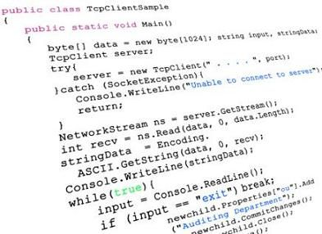
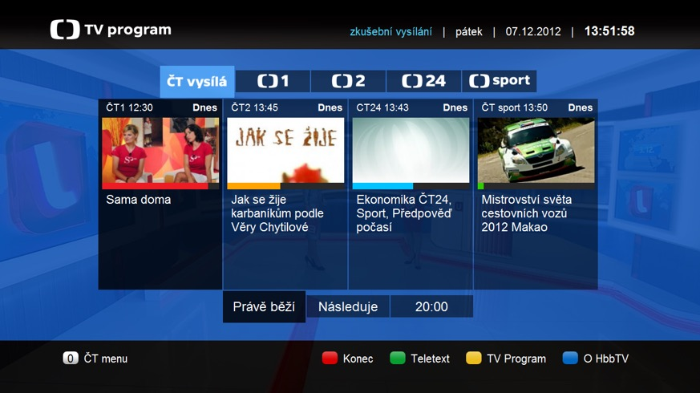
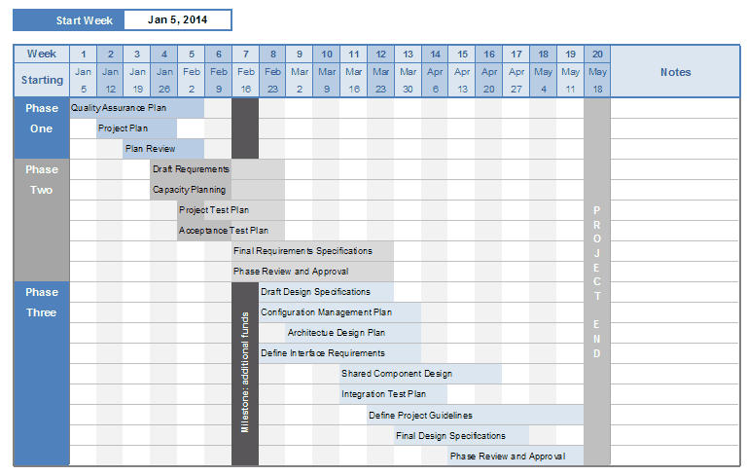

Slide 11
“A temporary, flexible organisation structure created to coordinate, direct and oversee the implementation of a set of related projects and activities in order to deliver outcomes and benefits related to an organisation’s strategic objectives; a programme is likely to have a life that spans several years.” (Managing Successful Programmes, UK Office of Government Commerce, 2007)
“A programme is a set of related projects and organisational changes put in place to achieve a strategic goal and to deliver the benefits that the organisation expects.” (IPMA Competence Baseline, International Project Management Association, 2006)
“A group of related projects managed in a coordinated way to obtain benefits and control not available from managing them individually. Programs may include elements of related work outside the scope of the discrete projects in the program.” (The Standard for Program Management, Project Management Institute, 2008)
Notes:
People in different industries and countries around the world have different understandings of what a 'program' is.
MSP has largely taken a top down, benefits based perspective whereby not all the projects are necessarily known at the outset.
PMI in the second edition program management standard was largely a bottom up perspective whereby a group of known projects on a similar theme (or technology) were grouped together for reasons of efficiency. These two definitions alone are quite philosophically different. Im not suggesting one is 'right' nor 'wrong'...
the ISO plenary we discussed examples from the aerospace industry - a program as both a new product development activity (eg developing the 787 aircraft type) as well as the production line activity to deliver 50 aircraft to one client. These two types are very different.
So do we continue the 'definition wars' and come up with the supreme, killer definition and then reject all others io do we select and existing one and tell all others that this is 'the' definiiton and theirs is wrong...

Slide 12
Program management
according to
project managers
Notes:
Concepts are not well understood

Slide 13
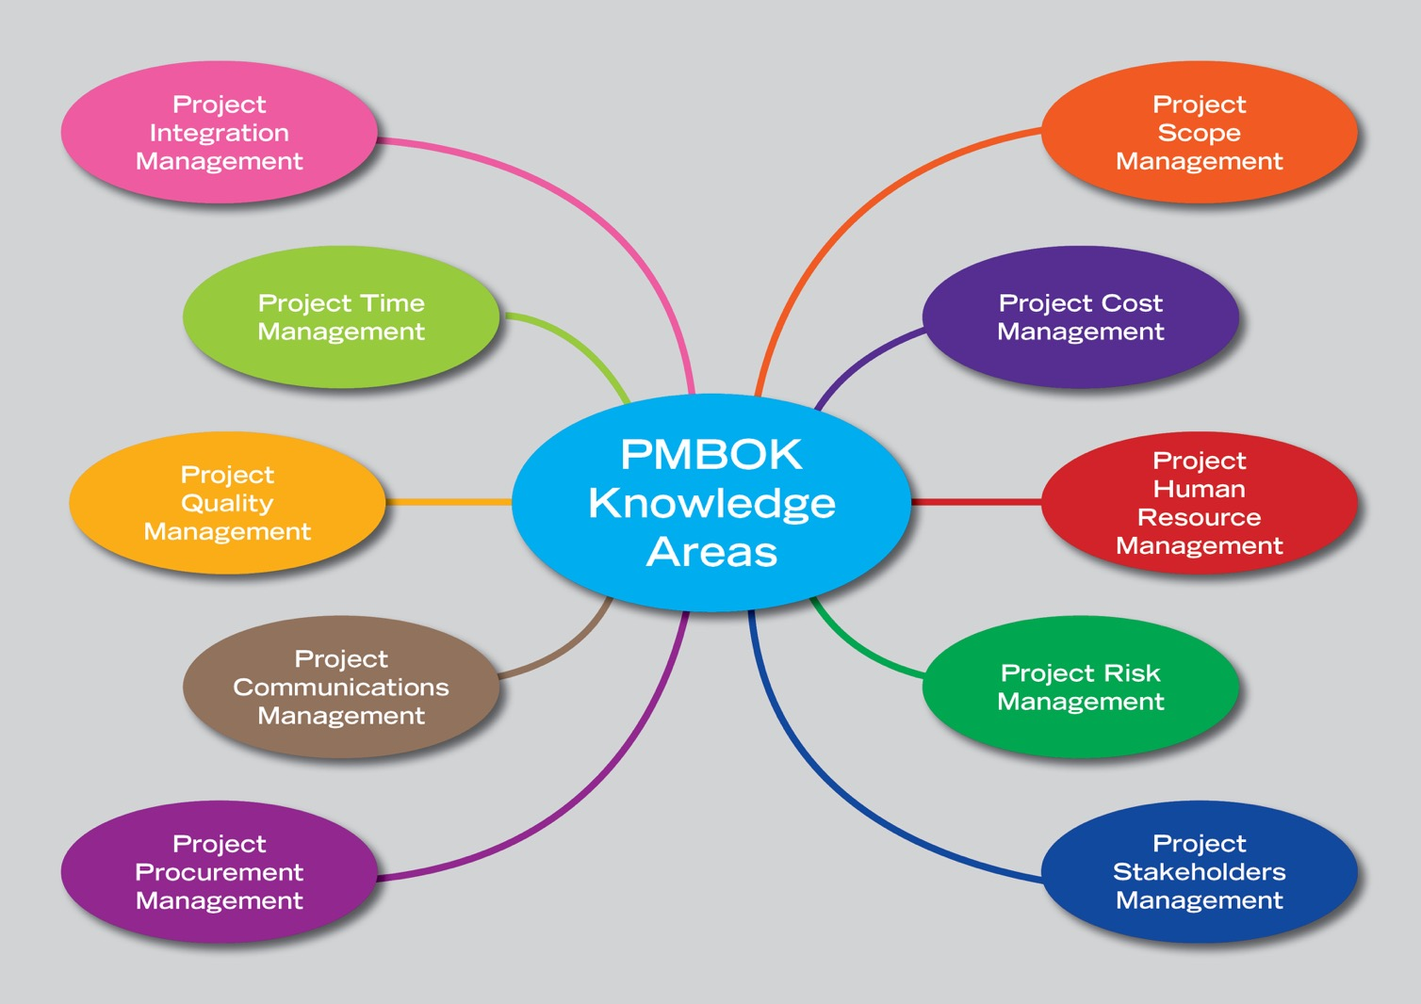
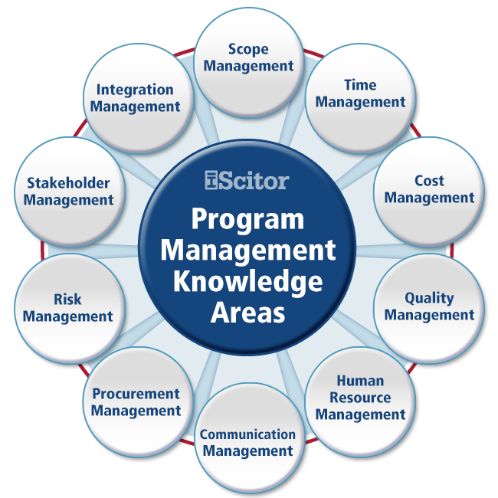
Notes:
Concepts are not well understood

Slide 14
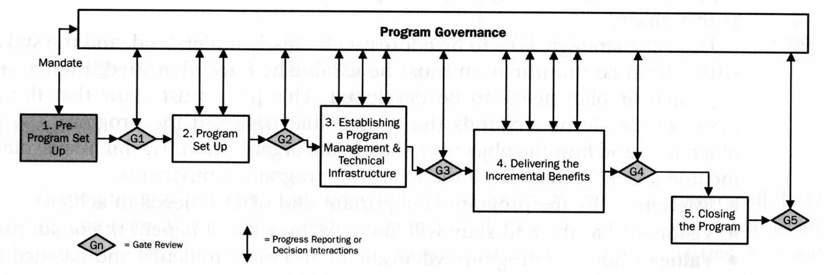
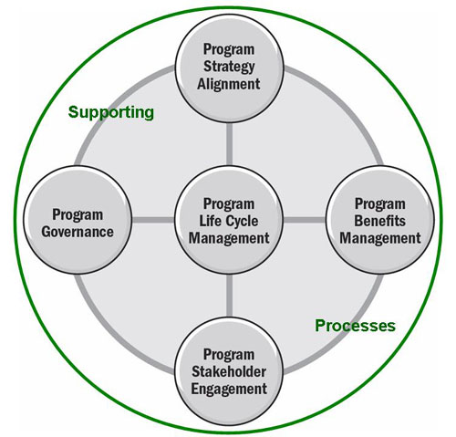
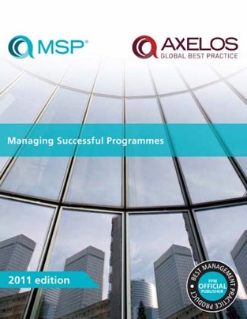
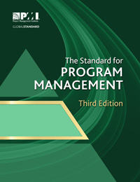
Notes:
Concepts are not well understood

Slide 15

ISO21504: Guidance on programme management
Notes:
Concepts are not well understood

Slide 16
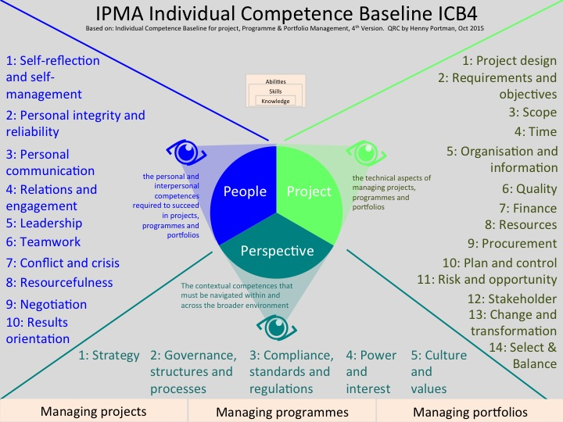
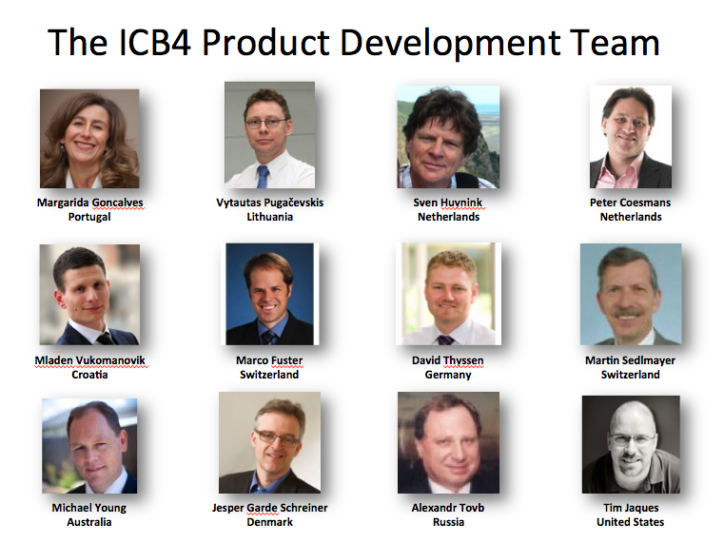
ICB4
Notes:
Concepts are not well understood

Slide 17
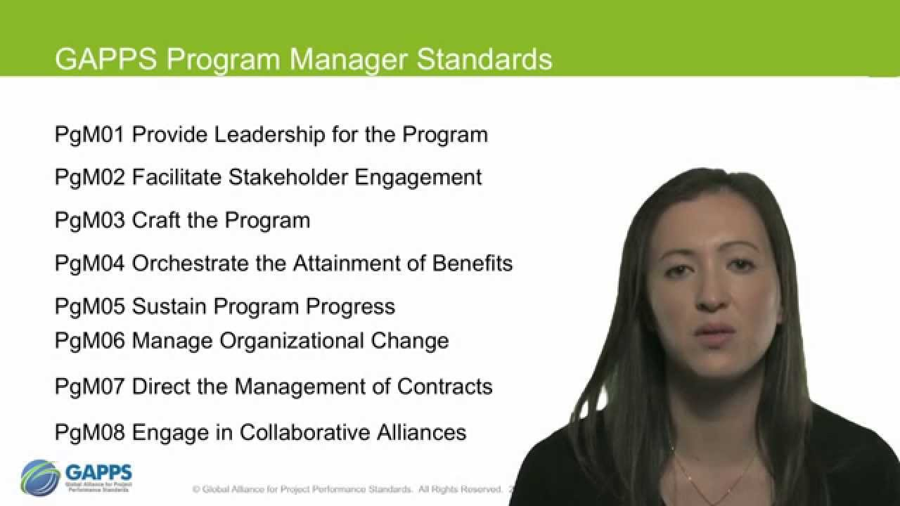
https://youtu.be/z9AjwnCOBaE
Notes:
Concepts are not well understood

Slide 18
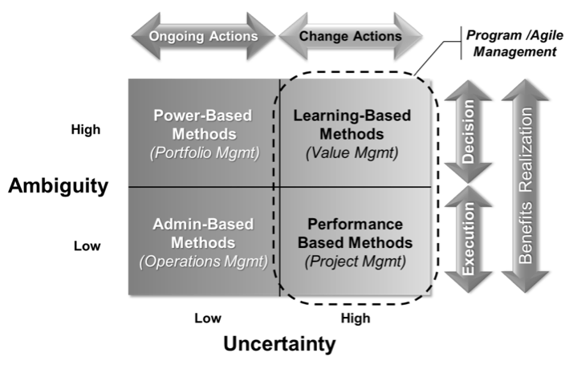
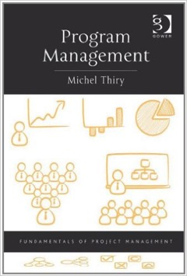
Notes:
Concepts are not well understood

Slide 19
The Academic Perspective
Scale up of project management
(7)
A management framework for initiatives
(14)
Approach to implement organisational change
(22)
Approach to implement strategic objectives / benefits
(22)
What is program management?
Notes:
Earliest paper was 1963 and the most recent was 2015.
Numbers are not the total of these 4 (65) – some papers mention more than category

Slide 20
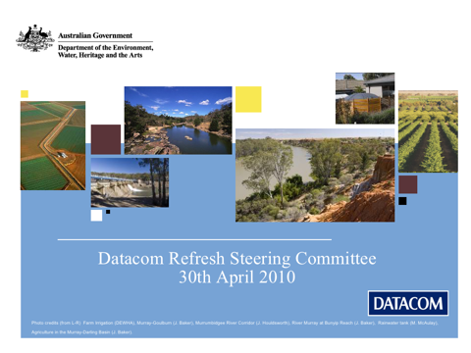
Notes:
Concepts are not well understood

Slide 21
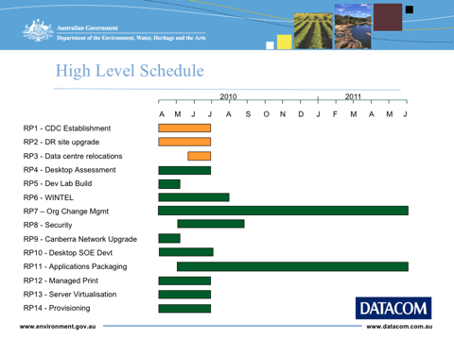

Slide 22
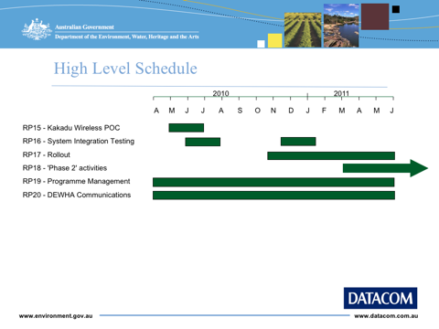

Slide 23
Challenges
‘Program’ was used by the CEO, General Managers etc…
They wanted an absolute guarantee when it would be delivered (a specific date) and for how much (to within $1)
Couldn’t understand why all these project managers were needed
No PMO
Removed PgM to save cost -> went to a single PM
Delivered 3 years late and $12M over budget
Seriously unhappy client and user rating in 5 years
Notes:
Couldn’t understand why all these project managers were needed
Didn’t want individual schedules
Wanted one report
Saw PMs as an overhead
Though I would manage everything!

Slide 24
Level of knowledge and maturity in organisations is low
Notes:
Program management standards are written by PMs

Slide 25
Results – P3M3 Maturity Levels

Slide 26

Case Study
Commonwealth Superannuation Corp.
Government owned Not-for-Profit
Manages public sector and military pensions
$4.8Bn under management
586,910 members
Notes:
Concepts are not well understood

Slide 27
Case Study
Notes:
Thought that the Prgm manager was:
- not competent
- Empiring building
Trying to fudge budget
Winging it

Slide 28
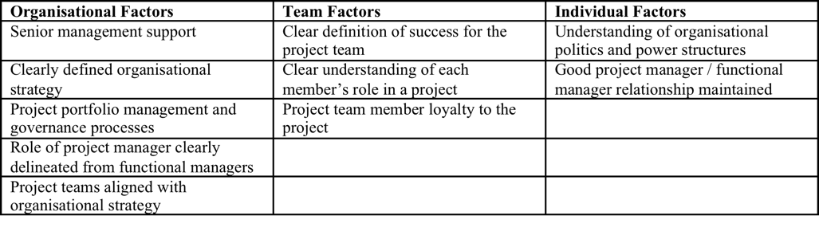
Challenges
Maturity models have holes and don’t measure everything (or necessarily the right things)
Research shows:
P3M3 ‘Generic Attributes’ are highly correlated to maturity
Top management support is the key! (but not measured by P3M3)
Notes:
Concepts are not well understood

Slide 29
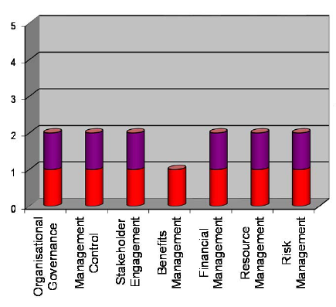
Challenges
A single number score is misleading
Research shows:
A pattern is more appropriate
Not all dimensions are equally important
Notes:
Concepts are not well understood

Slide 30
NOT independent, NOT equally important

Slide 31
NOT independent, NOT equally important
Financial mgt
Benefits
mgt
Management Control
Resource mgt
Organisational Governance
Risk mgt
Stakeholder mgt

Slide 32
Recommended P3M3 Targets

Slide 33
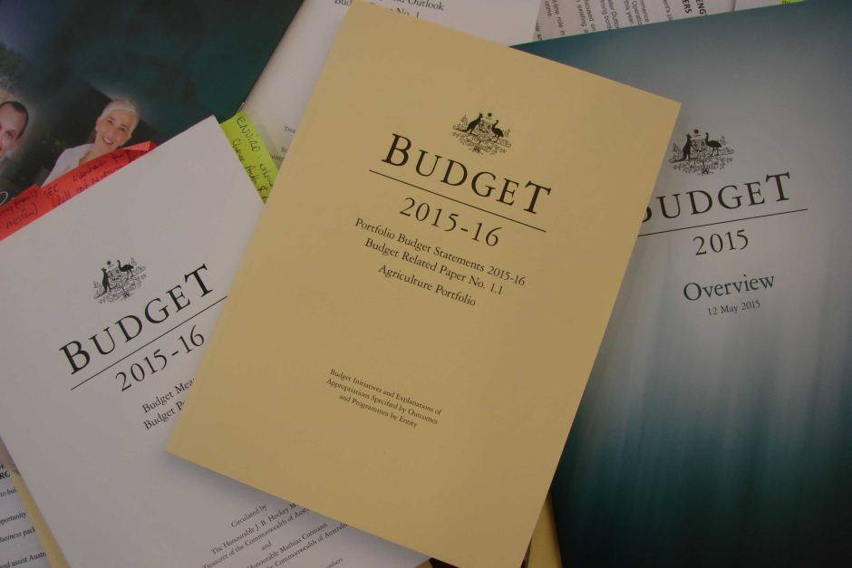


Slide 34

Context of the analysis
Understand Portfolio Budget Statement
  Funding allocation to programmes
  Expected relationship between programme objectives and effectiveness indicators
Validate programme-outcome logic
  Compare outcome measures against programme effectiveness indicators
  Identify inconsistencies if they exist

Slide 35
High level overview of outcomes
More productive and inclusive Australia
1. Best start in life
$396 m
3. Highly skilled, educated and productive community
$1,880 m
4. Participative and inclusive society
$2,952 m
2. Brighter future through education
$390 m
5. Safe, fair, successful workplace
$205 m
State contribution
State / private contribution

Slide 36
Outcome 1 - Best start in life
Best start in life
75-95% enrolled in childcare
High quality childcare
> # qualified carers
1.3 Early Childhood Education
$3m
Childcare <
8-12% income
1.2 Childcare fee assistance
$3,778m
% target groups enrolled
38 govt childcare centres
1.1 Support for the childcare system
$409m
Recognition of Prior Learning
TAFE fee waivers
Improved access to quality services
Information to assist families make informed decisions about childcare
National Quality Framework
Australian Early Development Index
families confident and have capabilities to support child’s development
Better social inclusion
Engaged / benefiting from educational opportunities
(Support workforce participation for families)
?
Children are born and remain healthy
nurturing, culturally appropriate, safe
child has knowledge and skills for life and learning

Slide 37
Outcome 2 - A brighter future through education
?
A brighter future through education
Quality teaching & learning environments
Workplace learning and career advice
Retention rate
78-79%
2.2 Non-govt schools national support
$7,749 m
COAG literacy / numeracy targets
2.1 Govt schools national support $0 m
Improved learning, literacy, numeracy
& educational attainment
2.4 Digital Education Revolution
$108 m
2.5 National action plan literacy & numeracy $6.8 m
2.6 Building the Education Revolution
$95 m
2.3 School support
$350 m
2.9 Smarter schools – improving teacher quality $37 m
2.11 Youth support
$128 m
2.12 School student assistance
$200 m
2.3 Trade training
$98 m
2.10 Students with disabilities $17 m
2.8 Smarter Schools – low SES communities $0 m
Disadvantaged have opportunity to develop skills
?
workforce skills
National trade cadetships
New pathways
?
?
?
MySchool 2.0
?
world class curriculum
Attracting and retaining highly qualified people

Slide 38
Challenges
Benefits management is not understood and poorly practiced
Benefits are often not measured (or even measurable)
Limited alignment between projects, programs and organisational strategy
Current benefits management thinking misses the biggest issues (and benefits) of all: sustainability…
Notes:
Concepts are not well understood

Slide 39
Facing some BIG problems?
Notes:
Peter Milsom turned me onto a book called six capitals that I will paraphrase from. The author states:
“So it has come to this. The global biodiversity crisis is so severe that brilliant scientists, political leaders, eco-warriors, and religious gurus can no longer save us from ourselves. The military are powerless. But there may be one last hope for life on earth: accountants.
”Excerpt From: Jane Gleeson-White. “Six Capitals, or Can Accountants Save the Planet?: Rethinking Capitalism for the Twenty-First Century.” iBooks. https://itun.es/us/dGwi1.l

Slide 40
What are the leading organisations doing?
Notes:
Concepts are not well understood

Slide 41
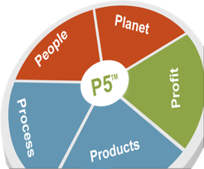
Portfolios
Business Case Management
Organizational Commitment & Usage | Standards & Competence | Continuous Improvement
Projects
Product Impacts
Objectives & Efforts | Lifespan & Servicing
Process Impacts
Maturity and Efficiency
Society
(People)
Environmental
(Planet)
Economic
(Profit)
Labor Practices & Decent Work
Society and Customers
Human Rights
Ethical Behavior
Transport
Energy
Water
Waste
Materials and Procurement
Return on Investment
Business Agility
Economic Stimulation
Employment
Labor/
Management
Relations
Health and Safety
Training and
Education
Organizational
Learning
Diversity and
Equal Opportunity
Trained
Professional
Emigration
Community
Support
Job/
Unemployment
Public Policy/
Compliance
Customer Health
and Safety
Market
Communications
and Advertising
Customer Privacy
Cultural Impact
Non-
Discrimination
Freedom of
Association
Child Labor
Forced or
Compulsory
Labor
Investment and
Procurement
Practices
Bribery and
Corruption
Anti-Competitive
Behavior
Digital
Communication
Traveling
Transport
Energy Used
Clean Energy
Return
Renewable Energy
Water Quality
Water
Consumption
Water
Displacement
Recycling
Practices
End of life disposal/ reusability
Waste Disposal
Co2 emissions
Air Quality
Noise Pollution
Good Neighbor
Materials used by weight or volume
Recycled input Materials
Sustainable Procurement Practices
Benefit Cost
Ratio
Direct Financial
Benefits
Sustainable Return on Investment
Net Present
Value
Flexibility/
Optionality
in the
project
Increased
Business
Flexibility
Local Economic Impact
Sustainable Profitability /Indirect Benefits
The GPM® P5™ Standard
For Sustainable Project Management
With Portfolio inclusions

Slide 42
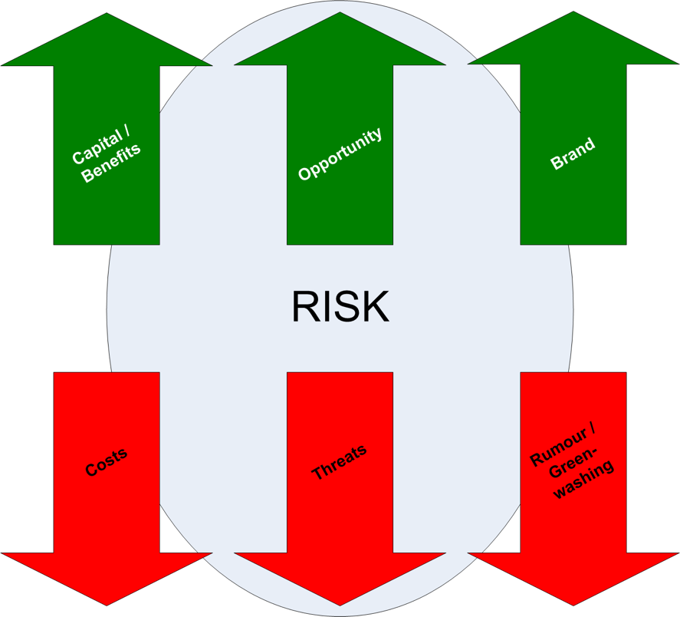
Expanded view of ‘benefits’
Need to consider (and maximize) the social, economic and environmental benefits to the business, customers, supply chain and stakeholders
It also aims to minimize negative impacts (economic social and environmental) of the program and the outcomes
Notes:
Many benefits not actually considered
Compliance is not enough any more
Benefits extend beyond the organisation
Society, customers, investors and stakeholders expect more

Slide 43
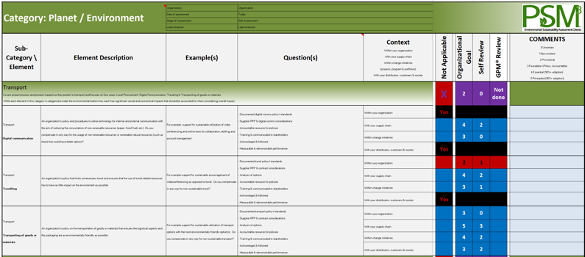
A Tailorable Context Specific Codex
Is required for sustainability
Different cultures, countries, industries and organizations have different areas of focus and priority
The analysis and reporting is tailored to each organizations goals, objectives and priorities
Four perspectives:
  Organisation
  Change initiatives
  Supply chain
  Stakeholders

Slide 44
Assessment Ranking is less “Subjective”
A unique model for evaluation
0
1
2
3
4
5
Undefined
Provisional
Foundational
Essential
Optimized
Principled
Zero sustainability practices in place and is at high risk. Ignores environmental and social regulations.
Has Ad-hoc sustainability policies and practices in place with little consistency.
Manages liability and adheres to all labor, health & safety, and environmental regulations
Makes proactive efforts to improve profitability by becoming eco-friendly.
Aligns corporate principles and values towards a sustainable model. Seeks out opportunities to improve products and services
Bases decisions on value creation to improve society and the environment through their products and services.

Slide 45
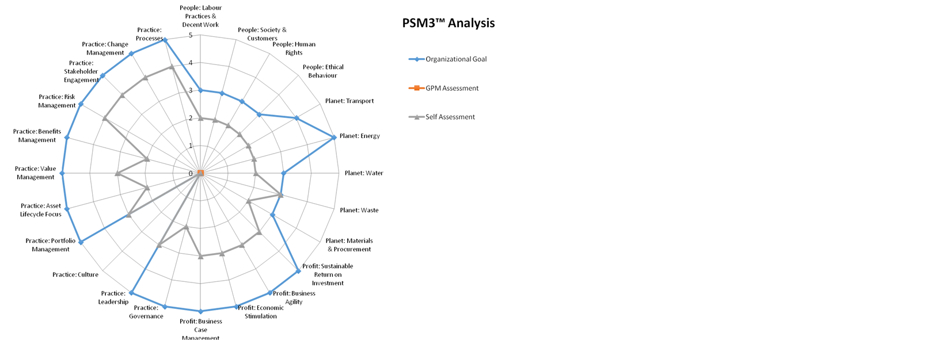
An example…

Slide 46
What’s at risk?
Research Shows that the value from sustainability challenges is substantial
Challenge
Example
Potential Impact % *EBITDA
Regulation/Reputation
Rising operating costs
Supply-chain disruption
Restricted license to operate
Reputational damage based on perceived misuse of resources
70
Raw-material costs driven up by supply/demand
True cost of water or carbon reflected in prices
60
Production delay or cancellation due to lack of access
Especially significant for local resources – water, power
25
*Earnings, interest, taxes, depreciation, and amortization
Source: http://www.mckinsey.com/insights/consumer_and_retail/getting_the_most_out_of_your_sustainability_program

Slide 47
The Opportunities…
“It has now been proved repeatedly across different industries and market segments, that sustainability initiatives can act as strong differentiating platforms for organizations”
Harvard Business Review
Notes:
Broaden your perspective – get on board the sustainability train

Slide 48
Imagine if…
Program managers were the architects of change that solved the world’s greatest challenges of our time…
What difference did you make in the world as a program manager?
Notes:
Sought after
Highly paid
Wouldn’t this be a much better question to ask in 10 years time than what do you mean by program management?

Slide 49
Thank you!
www.greenprojectmanagement.org
http://blog.greenprojectmanagement.org/
www.Facebook.com/greenprojectmanagement
Michael Young
michael@gpm.world
https://au.linkedin.com/in/michaelyoungcppd
Notes:
If you would like to learn more, contact ISOS.

